Slide 1
RESEARCH METHODS AND PROFESSIONAL PRACTICE
Economic Crisis Prediction
Research Proposal Presentation
Improving the Trade-off Between Interpretability and Statistical Accuracy in ML-Enhanced Crisis Prediction
Pavlos Papachristos
MSc Artificial Intelligence
PP24589
January 2026

Slide 2
Economic Crisis Prediction
Contents
Economic Crisis Prediction: Research Problem & Significance page 3
Literature Review - Evolution of Approaches page 4
Model Complexity vs Performance Trade-offs the Interpretability-Accuracy Paradox page 5
Early Warning Threshold Selection: Balancing Detection and False Alarms
Use Case: BIS Credit-to-GDP Gap Framework (I) page 6
Early Warning Threshold Selection: Balancing Detection and False Alarms
Use Case: BIS Credit-to-GDP Gap Framework (II) page 7
The Interpretability-Accuracy Paradox page 8
Machine Learning & Visual Analysis page 9
Traditional Visualisation Techniques page 10
Real-World Implementation & Critical Gaps page 11
COVID-19 Crisis: Early Warning System Validation page 12
Research Questions & Objectives page 13
Research Methodology & Design page 14
Project Timeline & Expected Outcomes page 15
References page 16
2

Slide 3
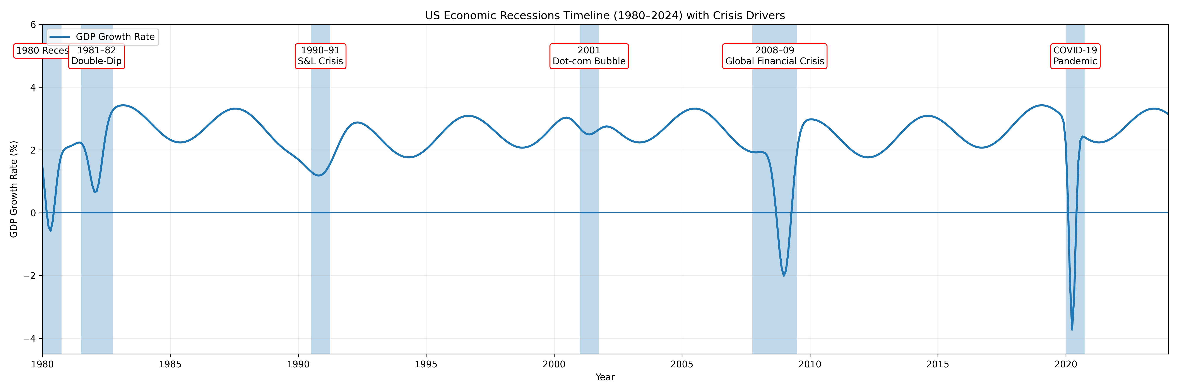
Economic Crisis Prediction: Research Problem & Significance
Financial crises generate systemic economic damage, including large output losses, unemployment, and sovereign debt stress.
The 2008 Global Financial Crisis (GFC) alone erased $2 trillion in global GDP.
Economic crises emerge abruptly, even though retrospective analysis often reveals early warning signals that were overlooked or misinterpreted.
Main Challenges in Economic Crisis Predictions
Traditional analytical tools prioritise model accuracy but often lack interpretability at the point of decision-making.
Policymakers face a growing translation gap between complex analytical outputs and actionable early-warning insights.
As a result, signals are detected too late, or their significance is not recognised in time for intervention.
A critical challenge: model accuracy comes at the cost of interpretability. Explainable AI and visualisation methods utilized to enable both.
The Importance of the Data Visualisation
Large-scale macro-financial datasets contain latent patterns and non-linear dynamics that are difficult to interpret numerically.
Visual analytics can surface these patterns, supporting earlier detection and more intuitive interpretation of emerging systemic risk.
When well-designed, visual tools can enhance policy relevance without sacrificing analytical rigour.
Historical Context: 6 major recessions in the past 45 years (avg every 7.3 years), Deepest: COVID-19 (-4%) and GFC (-3.5%)
Figure 1: US Economic Recessions Timeline (1980-2024) showing crisis drivers and economic impact. Source: Federal Reserve Bank of St. Louis (2024)
3

Slide 4
Literature Review - Evolution of Approaches
Methodological Foundation: The year 1998 (Kaminsky et al.) marks a methodological inflection point with the first systematic, multi-country early-warning system, establishing the signals approach that underpins modern crisis prediction.
Crisis Catalyst: The Asian Financial Crisis (1997-98) transformed the field from theoretical models to empirical, multi-country comparative analysis (Kaminsky & Reinhart, 1999).
Data & Computing Infrastructure: Post-1998 research benefits from major improvements in macro-financial data availability and standardization of cross-country databases (IMF, World Bank, BIS) and sufficient computing power for panel data analysis (Goldstein et al., 2000).
Visualization Technology: Period aligns with emergence of computational visualization tools essential for the data visualization techniques central to this research.
Continuity and relevance: The period from 1998 until now, captures the full methodological evolution from indicator-based models to network visualisation and interpretable machine learning approaches used in contemporary policy institutions.
Year | Key Development | Kew Researchers and References | Core Contribution
1998 - 1999 | Early Warning Systems | Kaminsky, Lizondo & Reinhart (1998); Kaminsky & Reinhart (1999) | Signals approach using multiple macro‑financial indicators; systematic cross‑country application. Key Features: 15 indicators, 20 countries, 70% accuracy within 24 months High false positive rates.
2000 - 2009 | Historical Pattern Analysis | Reinhart & Rogoff (2009) | Long‑run crisis databases; cross‑century visual comparison of debt, banking and currency crises. Key Features: Heat maps across centuries; Cross-country crisis comparison; Pattern recognition in 8 centuries.
2011 - 2014 | Network & Systemic Risk Visualisation | Battiston, Puliga, Kaushik, Tasca & Caldarelli (2012) | Network-based mapping of financial linkages Key Features: Institutional linkage mapping; Systemic risk propagation; DebtRank methodology.
2017-2025 | ML Integration & Interpretable AI | Joy, Rusnak, Smidkova & Vasicek (2017); Beutel, List & von Schweinitz (2019); Ariu, Broccardo, Hollstein & Tori (2020); Gholami, Guirguis & de Souza (2020); Molnar (2022) | Dimensionality reduction and explainable ML for crisis detection; improved predictive performance with interpretability. Key Features: 60 countries, 1980-2017; Principal Components Analysis, t-distributed Stochastic Neighbor Embedding (t-SNE) dimensionality reduction; Area Under the Curve (AUC) improvement: 0.78 → 0.81.
4

Slide 5
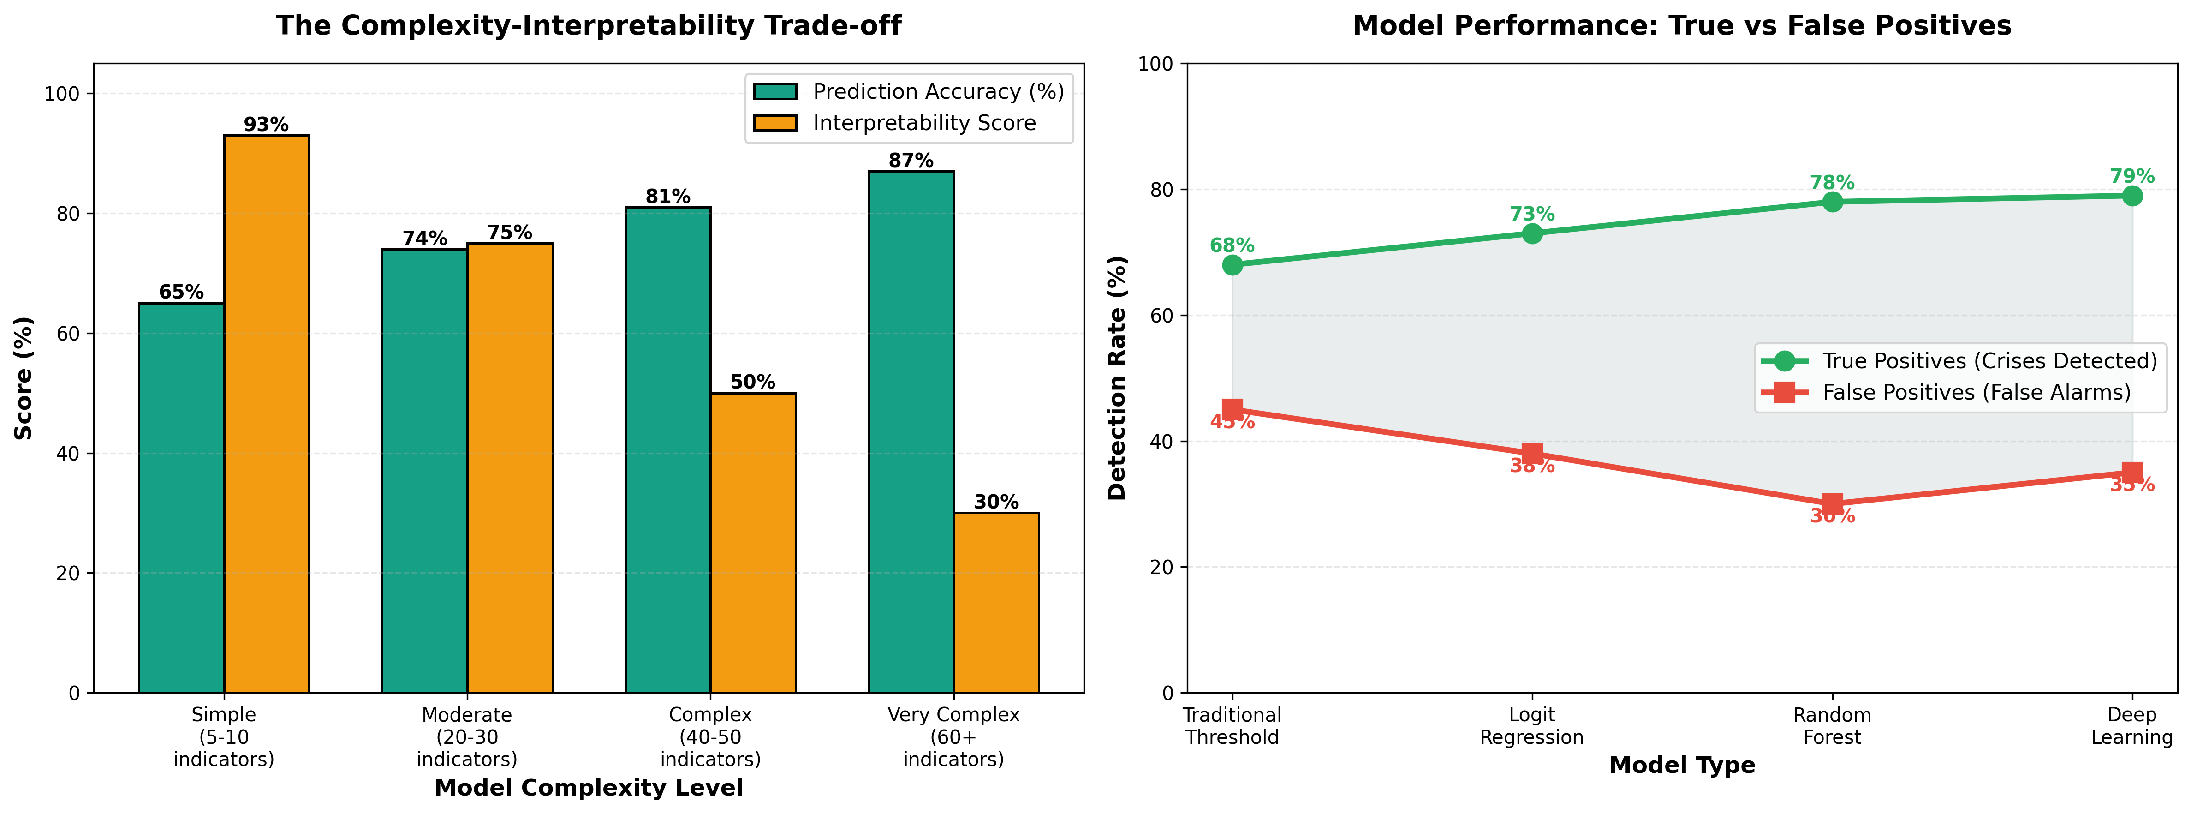
Model Complexity vs Performance Trade-offs
The Interpretability-Accuracy Paradox
Key insight: There is an inverse relationship between model complexity and interpretability. Analysis reveals diminishing returns beyond moderate complexity with major practical implications
Figure 2: Analysis based on Beutel et al. (2019), Joy et al. (2017), Gholami et.al. (2020) and Molnar (2022)
Simple (5-10 indicators; 65% accuracy, 93% interpretability). Basic signals approach using key macro-financial variables (e.g. Credit to GDP ratio), based on threshold models, easier interpretation (the Policy makers can easily understand "if credit grows >9% above trend, crisis risk increases“).
Moderate (20-30 indicators; 74% accuracy, 75% interpretability). Enhanced signals incorporating broader economic dimensions (e.g. banking sector health metrics), based on Logit regression with multiple dimensions. Good explainability, each indicator's contribution can be clearly identified.
Complex (40-50 indicators; 81% accuracy, 50% interpretability). Comprehensive multi-dimensional analysis including network effects (e.g. market sentiment indicators, sectoral credit data). Random Forest, ensemble methods. Difficult interpretation - create "black box" effects.
Very Complex (60+ indicators; 87% accuracy, 30% interpretability). Extensive feature sets and non-linear interactions (complex indicators plus alternative data sources e.g. social media sentiment). Deep Learning, neural networks with multiple hidden layers. Very hard to interpret the parameter interactions.
5

Slide 6
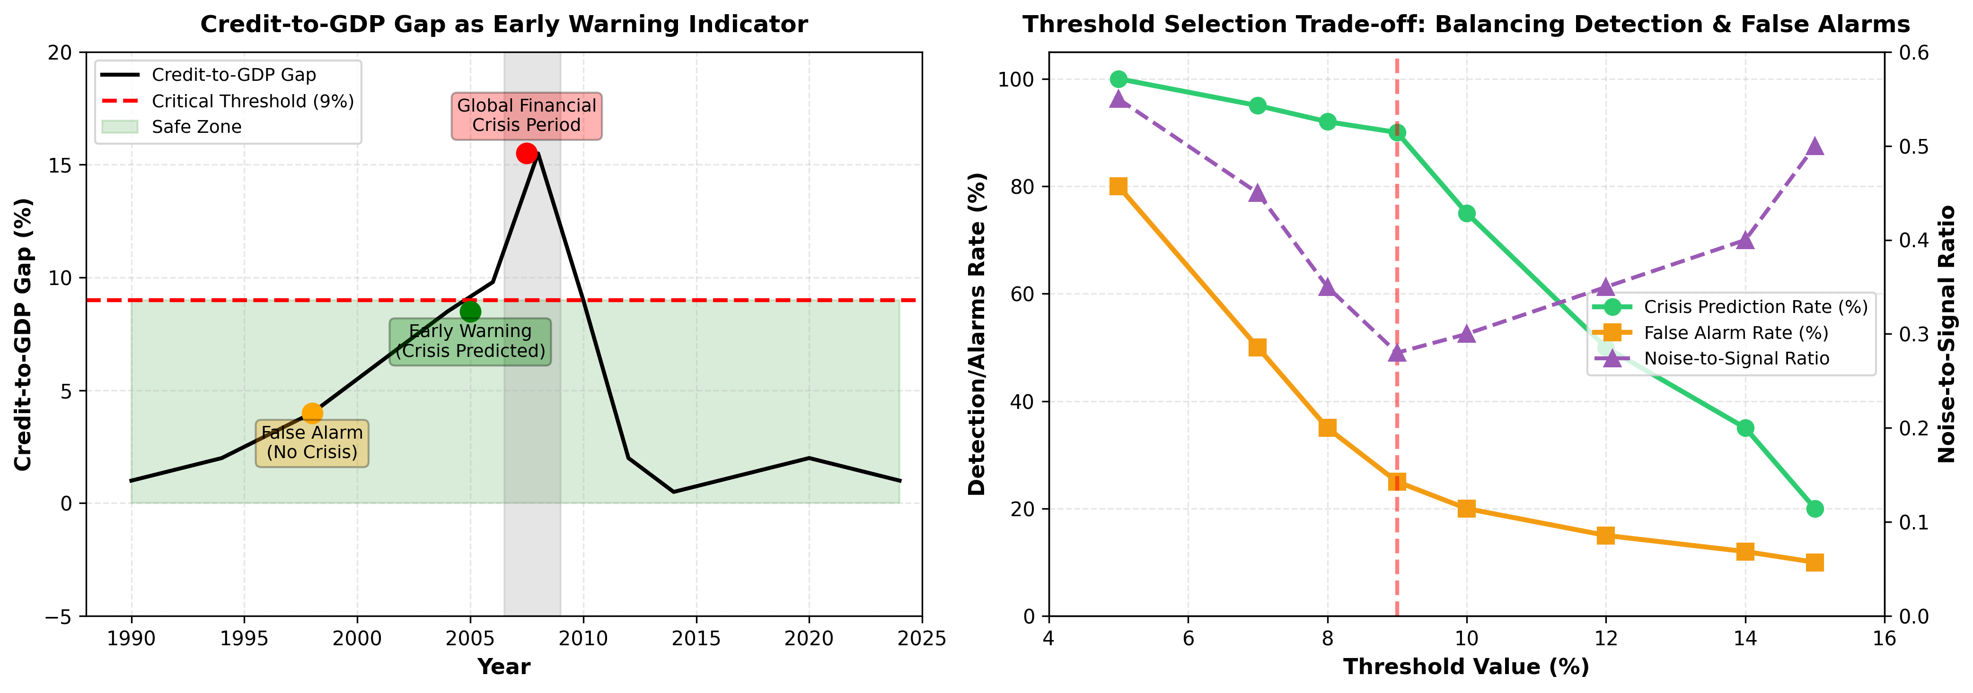
Early Warning Threshold Selection: Balancing Detection and False Alarms - Use Case: BIS Credit-to-GDP Gap Framework (I)
Figure 3: BIS Credit-to-GDP Gap analysis demonstrating threshold selection trade-offs, Drehmann, M. & Juselius, M. (2014)
• High Detection Rate: Captures 90% of systemic banking crises, providing reliable early warning.
• Low rate of False Alarms: 25% false positive rate maintains policy credibility—too many false alarms and regulators stop paying attention.
• Sufficient Lead Time: Provides 5-10 quarters advance warning, giving policymakers time to implement countercyclical measures.
• Global Adoption: Basel III incorporated this threshold for capital buffer requirements, demonstrating how visualization research translates to operational policy
6

Slide 7
Early Warning Threshold Selection: Balancing Detection and False Alarms - Use Case: BIS Credit-to-GDP Gap Framework (II)
Economic crisis prediction research reveals a fundamental tension: the most statistically accurate models may not be the most useful for regulatory policy.
Basel III adopted a simple threshold-based approach.
This decision reflects the trade-offs between statistical optimality and operational feasibility.
Regulatory frameworks prioritize transparency, legal defensibility, and operational feasibility over marginal predictive gains.
Simple rule consistently implemented outperforms a complex model that faces governance challenges and resistance to adoption.
Academic Research: Logit Models Performance-Optimized Approach | Basel III: Simple Threshold Policy-Feasible Implementation
Advantages Higher predictive accuracy (AUC ~0.82) Multi-indicator integration capability Probability-based decision framework Flexible calibration options Superior statistical properties | Regulatory Advantages Transparent and legally defensible Minimal data requirements Cross-country harmonization enabled Low Model Risk Management burden Clear activation trigger for buffers
Implementation Barriers "Black box" perception by policymakers Complex model governance requirements Data requirements across jurisdictions Difficult to defend in legal challenges Parameter uncertainty and drift | Trade-offs Moderate predictive accuracy (AUC ~0.75) Single-indicator limitation Higher false alarm rate (~25%) Less flexible calibration Potential for threshold gaming
7

Slide 8
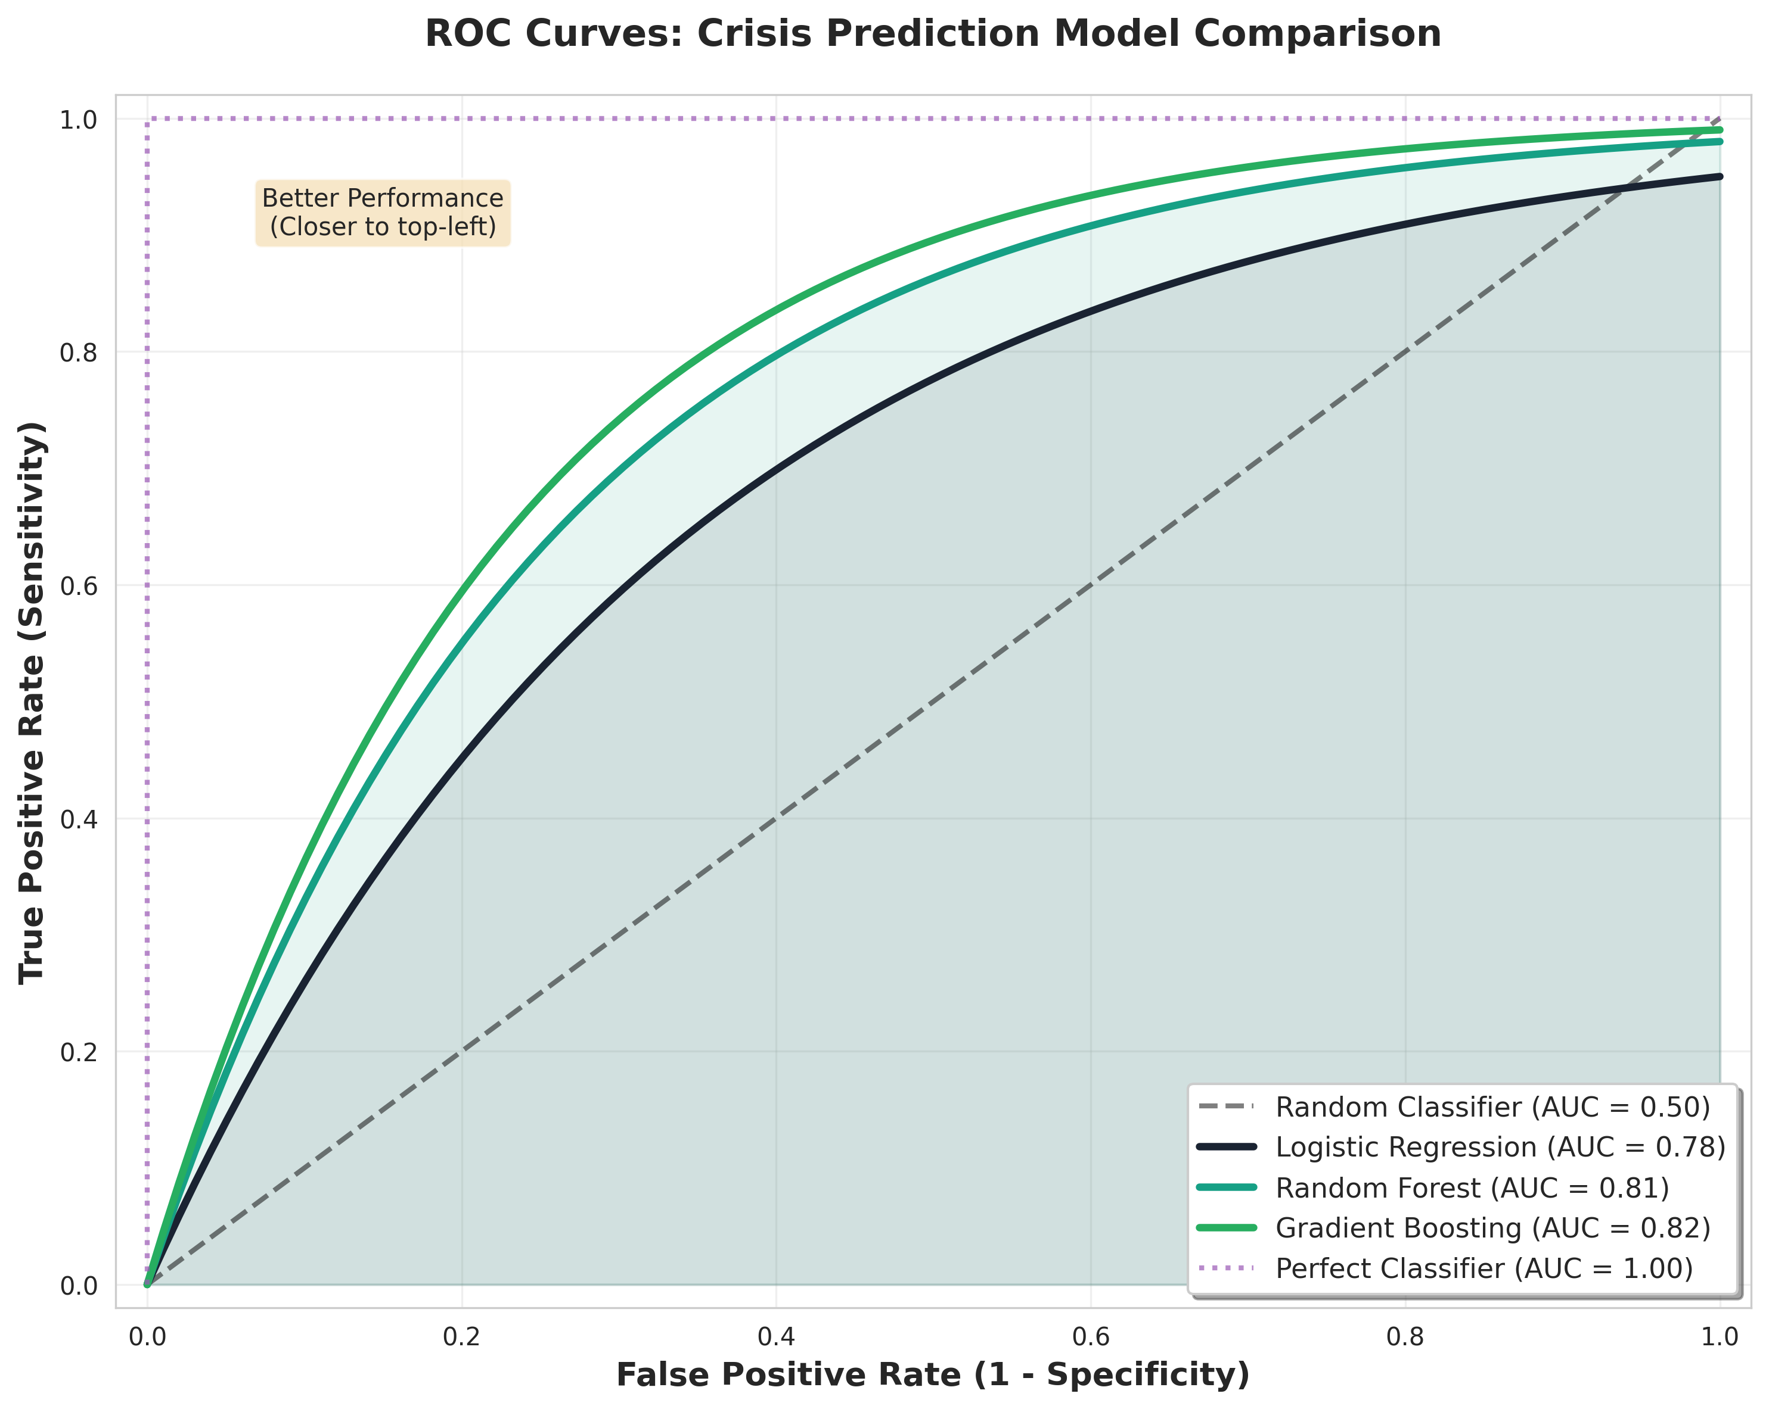
The Interpretability-Accuracy Paradox
Modern machine learning models achieve higher statistical accuracy (AUC 0.81-0.87) but create "black box" systems that policymakers cannot interpret or trust. Traditional simple models offer transparency but sacrifice predictive power (AUC 0.65-0.75).
High accuracy + Low interpretability → Policymakers cannot justify interventions based on opaque outputs
Low accuracy + High interpretability → Frequent false alarms erode credibility and lead to policy inaction
Current approaches force a binary choice between accuracy and interpretability.
This research demonstrates that high accuracy and high interpretability are NOT mutually exclusive through explainable AI (Ariu et al. 2020) and enhanced visualisation.
BLACK BOX Current ML Models High accuracy but policymakers can't trust opaque outputs | THIS RESEARCH TARGET Explainable ML (Ariu et al. 2020) High accuracy WITH interpretability through SHAP/LIME + visualisation
Neither accurate nor understandable | TRADITIONAL SIMPLE MODELS Logit, Thresholds Transparent but frequent false alarms
Figure 4: Private sector debt analysis showing accumulation patterns and sustainability thresholds across economic cycles. Rising debt-to-GDP ratios above historical trends signal increased crisis risk. Claessens & Kose (2014) and Reinhart & Rogoff (2009).
8

Slide 9
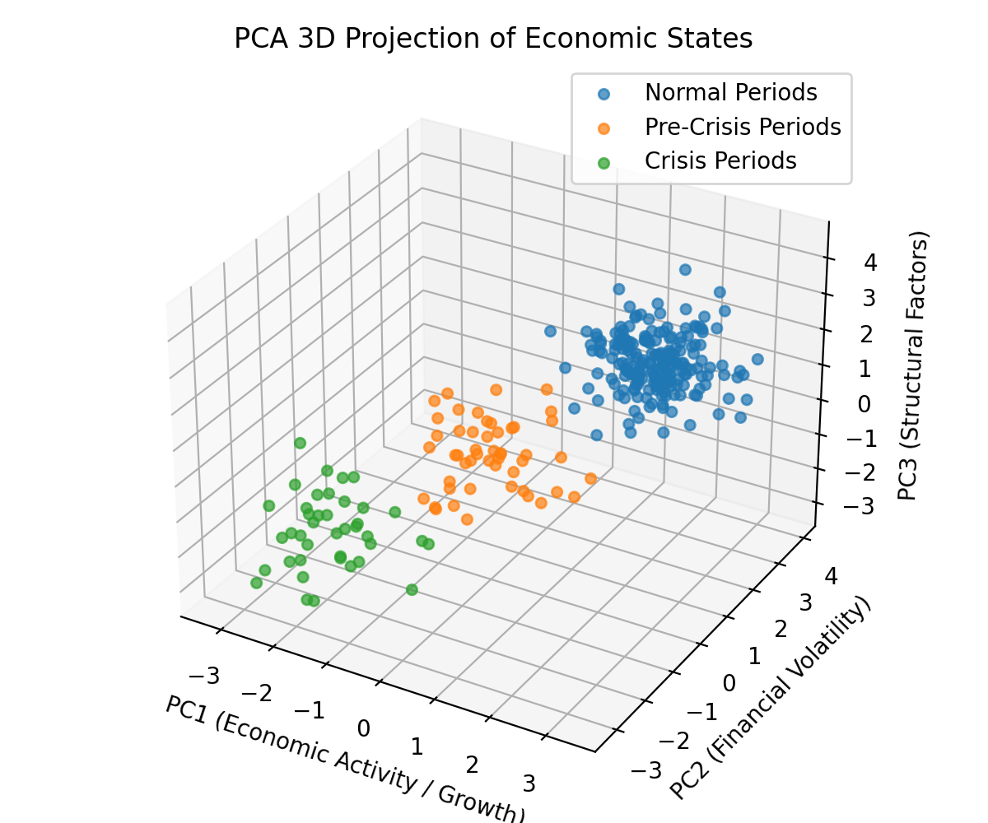
Machine Learning & Visual Analysis
Machine learning integration with visualization techniques enables dimensionality reduction and pattern recognition across high-dimensional indicator spaces.
Important caveats exist regarding what ML models actually detect versus what they discover.
ROC Curve Analysis:
Alessi & Detken (2018) demonstrated how Receiver Operating Characteristic (ROC) curves provide visual performance evaluation across classification thresholds, enabling assessment of sensitivity-specificity trade-offs critical for policy threshold setting. ROC curves plot True Positive Rate (sensitivity) against False Positive Rate (1-specificity) at various decision thresholds.
Dimensional Reduction: PCA 3D Visualization
Beutel et al. (2019) applied Principal Component Analysis (PCA) and t-SNE to compress high-dimensional financial indicator spaces (60+ indicators) into dimensional visualizations, revealing clustering patterns and crisis proximity that would be invisible in raw tabular data.
The 3D visualization reduces 60 macro-financial indicators to three principal components explaining variance across economic states. The visualization shows three distinct clusters represented by different markers:
Normal Periods (n=200, blue circles) that represent stable economic conditions.
Pre-Crisis Periods (n=50, orange circles) a transitional cluster between normal and crisis states (characterized by above-trend economic expansion, rising asset price volatility, rapid credit growth).
Crisis Periods (n=40, green circles), characterized by severe GDP contraction, extreme market volatility and systemic banking stress.
The three principal components represent:
PC1 ~ 35% of variance capturing Economic Activity based on dominant loadings.
PC2 ~ 25% of variance based on Financial Volatility related indicators.
PC3 captures residual variation.
Clusters illustrate how PCA can separate normal, pre-crisis, and crisis periods without relying on explicit network connections.
It supports interpretability by allowing policymakers to observe transitions directly in reduced-dimensional space
Figure 5: PCA 3D Visualization - Clustering of Economic States, Beutel et al. (2019)
9

Slide 10
Traditional Visualisation Techniques
Visualization Technique | Application | Key Strengths | Limitations
Time-Series Charts | Tracking indicator trends over time for individual macro-financial indicators (e.g., credit growth, debt ratios). | • Intuitive—everyone understands lines going up or down • Clear communication with non-technical audiences • Effective for showing temporal patterns • Easy to identify trend breaks | • Limited to single indicators. • Miss multivariate interactions (e.g., credit booms + current account deficits). • Poor representation of complex relationships.
Heat Maps | Pattern recognition across multiple dimensions (e.g., country-crisis matrices). | • Compress centuries of data into visual patterns • Reveal recurring crisis templates • Effective for comparative analysis • High information density | • Temporal dynamics lost—see patterns but not sequence • Static representation limits understanding • Risk of oversimplification
Interactive Dashboards | Flexible exploration of multi-dimensional data and scenario analysis. | • Enable drill-down by region, time, sector • Support hypothesis testing • Allow customized views • Facilitate real-time monitoring. | • Risk of visual p-hacking: find patterns in noise (Few, 2009) • Requires user expertise • Limited validation of decision improvement
Traditional visualization techniques form the foundation of crisis monitoring systems used globally by the IMF, BIS, and central banks.
Time-series charts pioneered by Claessens & Kose (2014) show that steepening slopes in credit growth reliably precede crises.
Heat maps, developed by Reinhart & Rogoff (2009), compress eight centuries of financial crisis data into visual patterns.
Each approach offers distinct advantages well for low-dimensional analysis but scale poorly to complex, high-dimensional data.
These limitations motivate the integration of explainable AI with advanced visual analytics—bridging interpretability and accuracy rather than forcing a choice between them.
10

Slide 11
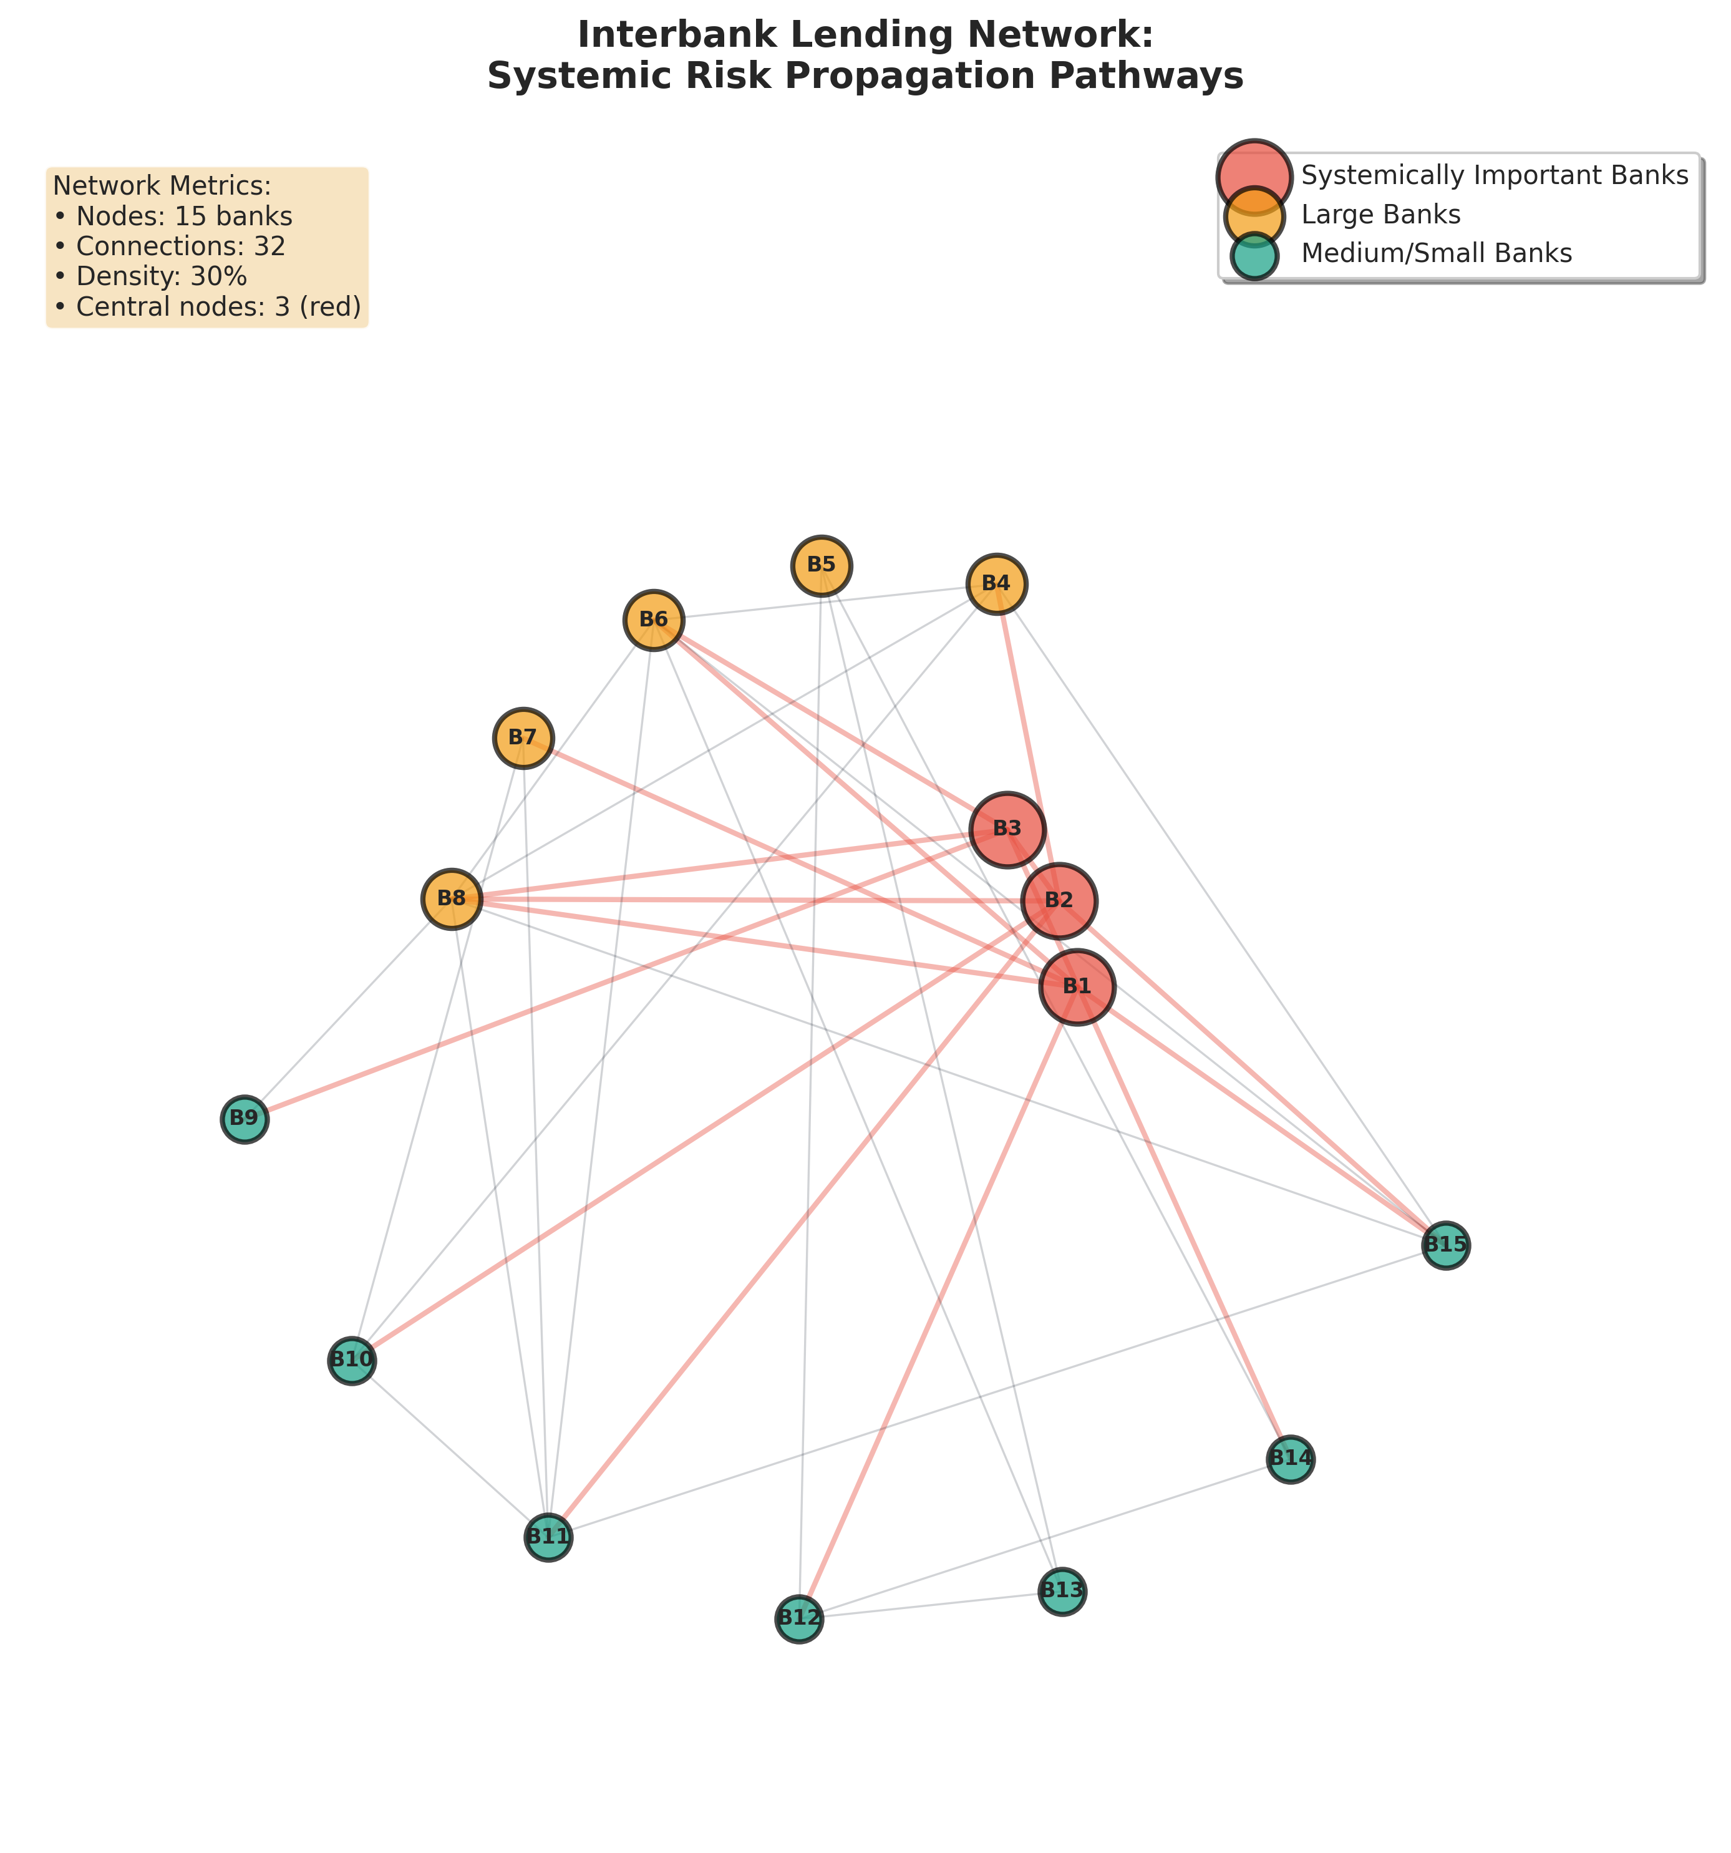
Real-World Implementation & Critical Gaps
Feature | IMF Financial Soundness Indicators | ESRB Risk Dashboard
Geographic Coverage | 200+ countries globally | 19 Eurozone countries
Indicator Scope | 40+ macro-financial indicators | Network analysis + macro indicators
Primary Focus | Global comparability and standardization | Systemic risk and contagion pathways
Analytical Approach | Individual country vulnerability assessment | Network-based interconnection analysis
Key Strength | Breadth: identifies vulnerable countries relative to peers | Depth: reveals how institutional interconnections create contagion risk
Visualization Type | Time-series dashboards, heat maps | Network graphs, interactive node-link diagrams
Critical Limitation | Lacks rigorous validation against holdout data. | Lacks rigorous validation against holdout data
Figure 6: Interbank lending network showing systemic risk propagation pathways. The network reveals systemically important financial institutions('too large’ to fail) through centrality measures (Battiston et.al. (2012).
Critical validation gap: Neither system provides rigorous evidence of predictive accuracy on holdout data, highlighting the need for evidence-based evaluation frameworks.
Major financial institutions implement visualization-based crisis monitoring, revealing both the promise and practical limitations of translating research into operational systems.
The IMF prioritizes breadth—200 countries, 40+ indicators, ensuring global comparability and standardization, making it excellent for identifying which countries look vulnerable relative to peers.
The ESRB prioritizes depth—focused on 19 Eurozone countries but incorporates network analysis showing how institutional interconnections create contagion pathways.
Network visualization reveals "too central to fail" institutions where failure would trigger cascading systemic collapse.
11

Slide 12
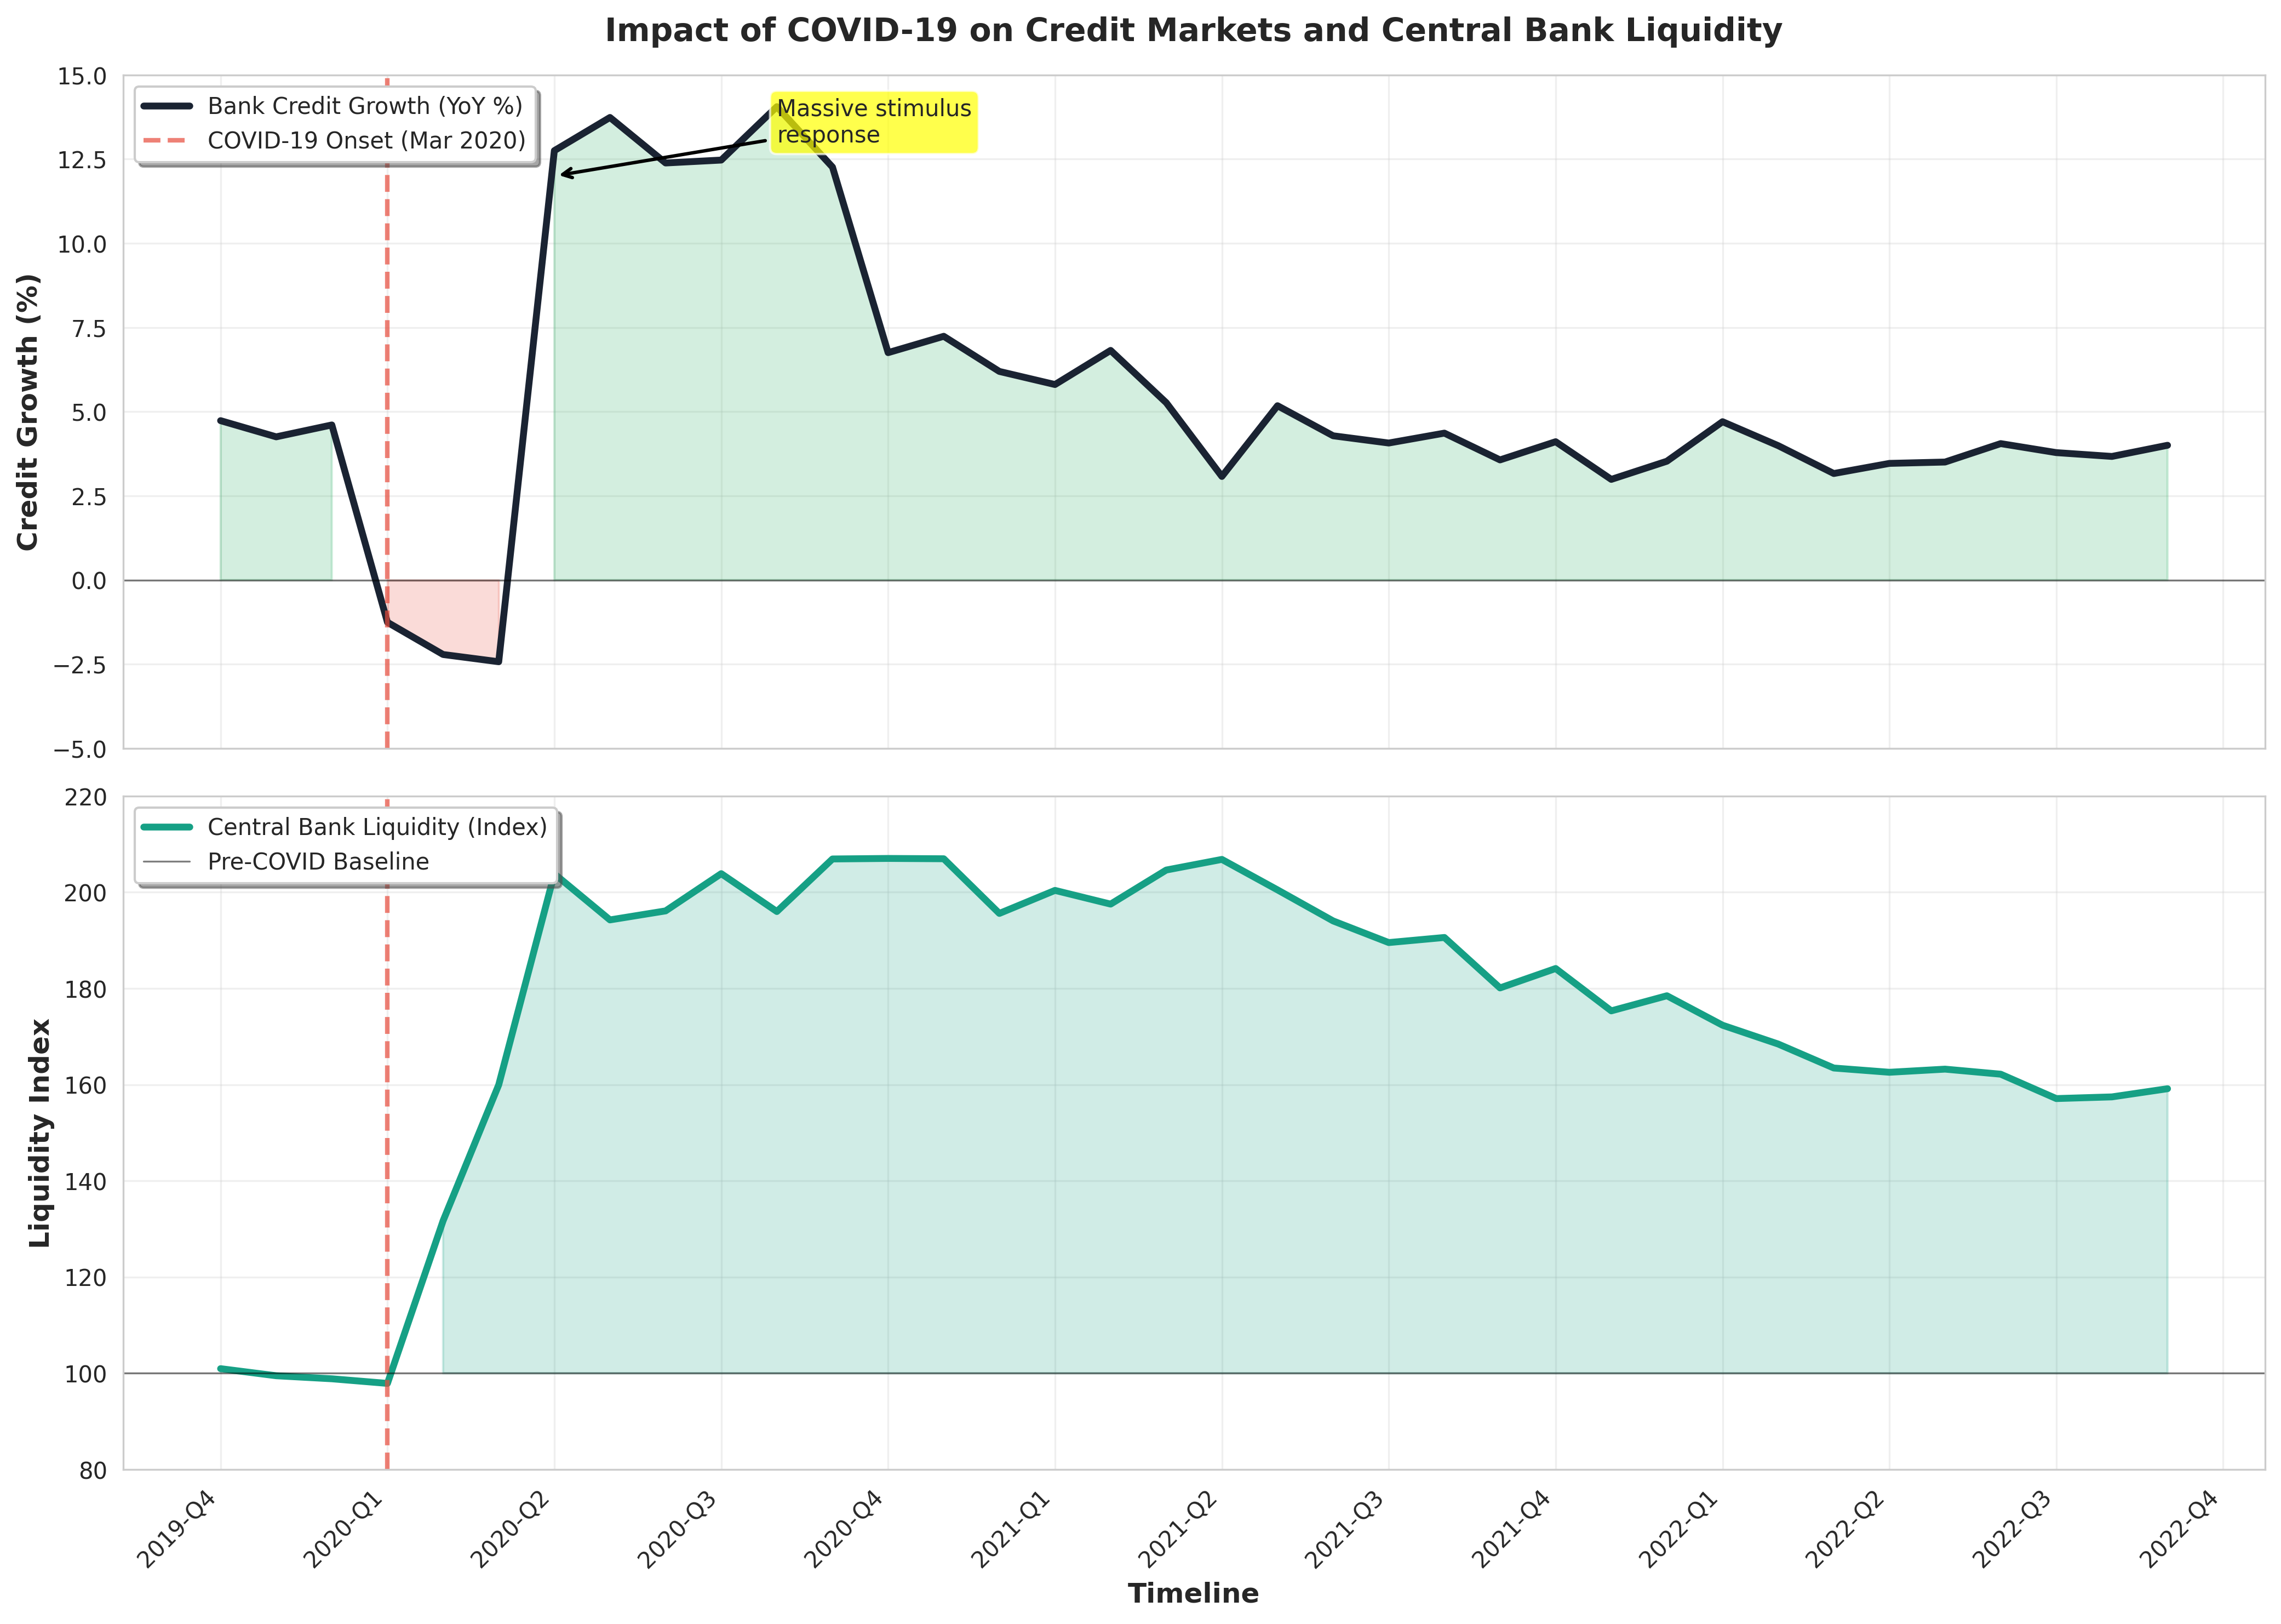
COVID-19 Crisis: Early Warning System Validation
The COVID-19 pandemic demonstrates the critical need for interpretable early warning systems capable of detecting rapid credit market decline
Figure 7: COVID-19 impact on credit markets and central bank liquidity. Source: BIS (2024)
Crisis Dynamics:
Credit growth: 12.5% → negative (one quarter)
Central bank liquidity: 100 → 200+ index (unprecedented intervention)
Traditional systems: Detected crisis only after onset
Recovery timeline: 12+ quarters of sustained policy support
Research Implications:
Early warning systems must balance rapid detection, interpretable thresholds, and policymaker trust—the core focus of this research.
12

Slide 13
Research Questions & Objectives
MAIN RESEARCH QUESTION
How can explainable AI techniques and data visualisation improve the trade-off between interpretability and statistical accuracy in economic crisis prediction models?
1. Model Performance: Maintaining Accuracy with Interpretability
Can explainable AI techniques (SHAP, LIME) maintain predictive accuracy (AUC >0.80) while enabling human interpretation of model decisions?
2. Visualisation Effectiveness: Communicating Complex Outputs
Which specific visualisation techniques (SHAP plots, partial dependence plots, temporal heatmaps) most effectively communicate model outputs to non-technical policymakers?
3. Policy Implementation: Design Principles for Operational Systems
What design principles maximise interpretability without sacrificing analytical rigor in operational early warning systems used by central banks and regulatory authorities?
RESEARCH AIM
Develop an evidence-based framework demonstrating that high statistical accuracy and high interpretability are NOT mutually exclusive, through the integration of explainable AI (following Ariu et al. 2020) with strategic data visualisation.
SPECIFIC RESEARCH OBJECTIVES
1. Systematic Literature Synthesis: Conduct comprehensive review (1998-2025) of visualisation techniques in financial crisis prediction, establishing the current state of knowledge.
2. Comparative Model Analysis: Empirically compare traditional, ML, and explainable ML approaches using BIS/IMF data across 60+ countries (1980-2025), quantifying accuracy-interpretability trade-offs.
3. Visualisation Design Framework: Develop evidence-based design principles for interpretable ML-enhanced early warning dashboards that communicate complex model outputs effectively
4. Stakeholder Validation: Evaluate framework effectiveness through structured assessment with 8-12 risk management professionals from banking and regulatory sectors.
5. Policy Recommendations: Translate findings into actionable implementation guidelines for regulatory authorities (central banks, IMF, ESRB) with clear adoption pathways.
13

Slide 14
Research Methodology & Design
Methodological Approach: Quantitative comparative analysis replicating and extending Ariu et al. (2020)
1. Data Collection & Preparation
Dataset: BIS Financial Stability Indicators (1970-2024).
Credit-to-GDP gaps, debt service ratios, property prices.
43 advanced and emerging economies.
Crisis Definition: IMF/BIS taxonomy - banking, currency, sovereign debt crises.
Feature Engineering: 12-quarter rolling windows for leading indicators
4. Visualization Enhancement Strategy
Traditional Methods:
Time-series decomposition with crisis annotations; Threshold heatmaps (Policy Maker view); Correlation matrices with temporal dynamics
Advanced Techniques:
3D PCA projections of crisis states; Interactive dashboards (Dash framework); Network analysis of indicator
2. Model Development Pipeline
Baseline Models (Replication):
Logistic Regression (benchmark interpretability.)
Random Forest (ensemble baseline).
Neural Networks (accuracy benchmark).
Enhanced Models (Innovation):
XGBoost with SHAP explanations.
Attention-based LSTM with visualization layer.
Interpretable Neural Network ensemble.
5. Expected Deliverables
Working prototype: Interactive early warning dashboard
Comparative analysis: Traditional vs ML-enhanced approaches
Policy framework: Interpretable threshold recommendations
Technical documentation: Replication package with code
3. Evaluation Framework
Statistical Accuracy:
Area Under Curve (AUC-ROC)
Precision-Recall curves
Type I vs Type II error trade-offs
Target: Match or exceed Ariu et al. (0.81-0.87 AUC)
Interpretability Assessment:
SHAP value extraction and ranking
Feature importance stability analysis
Policy-relevant threshold identification
Limitations & Risk Mitigation
Data availability: Backup dataset from IMF IFS if BIS access limited
Computational constraints: Cloud resources (Google Colab Pro) for model training
Time constraints: Modular development allows incremental delivery.
14

Slide 15
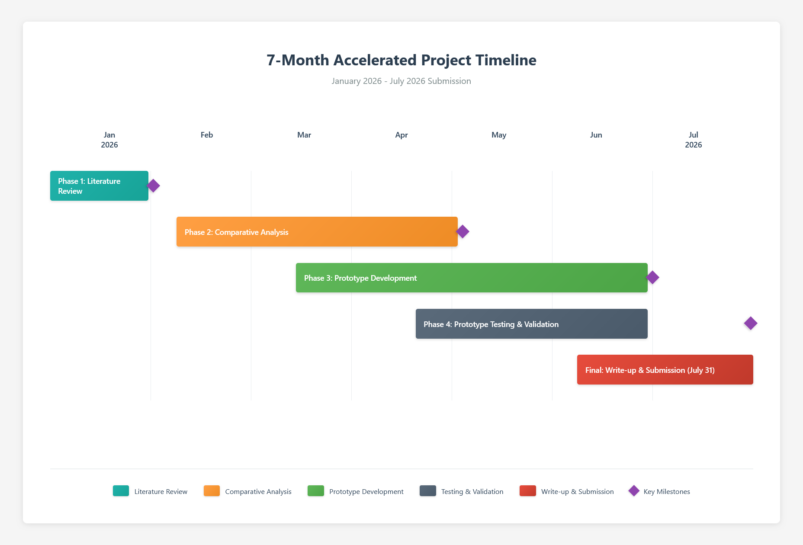
Project Timeline & Expected Outcomes
Key Deliverables
1. Working Prototype
Interactive early warning dashboard (Python based) with crisis probability visualization and real-time indicator tracking.
2. Comparative Analysis
- Systematic evaluation: Traditional models vs ML-enhanced approaches.
Performance target: AUC ≥0.81 with improved interpretability.
3. Policy Framework
- Evidence-based threshold recommendations with Type I/II error optimization.
Explainable AI framework showing which indicators drive each crisis prediction
4. Technical Documentation
Replication package with documented code, data preprocessing, and analysis.
Success Criteria
- Statistical: AUC-ROC ≥0.81 (Ariu et al. benchmark)
- Interpretability: Shapley Additive Explanation (SHAP) with >0.85 consistency, demonstrating reliable identification of key crisis indicators across model runs.
- Completion: All deliverables by July 31, 2026.
Risk Mitigation Strategies
- Data access: Primary source BIS Statistics, IMF IFS as backup.
- Computational resources: Cloud-based GPU platforms adequate for neural network training.
- Timeline management: Modular development approach ensures flexibility and incremental delivery.
15

Slide 16
References
Alessi, L. and Detken, C. (2018) 'Identifying excessive credit growth and leverage', Journal of Financial Stability, 35, pp. 215-225. doi: 10.1016/j.jfs.2017.06.005
Ariu, A., Comelli, F. and Tosti, E. (2020) 'Predicting banking crises with machine learning', IMF Working Paper, WP/20/3. Washington, DC: International Monetary Fund. Available at: https://www.imf.org/en/Publications/WP/Issues/2020/01/10/Predicting-Banking-Crises-with-Machine-Learning-48895 (Accessed: 6 January 2026).
Bank for International Settlements (2024) Financial Stability Indicators. Basel: BIS. Available at: https://www.bis.org/statistics/index.htm (Accessed: 6 January 2026).
Battiston, S., Puliga, M., Kaushik, R., Tasca, P. and Caldarelli, G. (2012) 'DebtRank: Too central to fail? Financial networks, the FED and systemic risk', Scientific Reports, 2, article 541. doi: 10.1038/srep00541
Beutel, J., List, S. and von Schweinitz, G. (2019) 'Does machine learning help us predict banking crises?', Journal of Financial Stability, 45, article 100693. doi: 10.1016/j.jfs.2019.100693
Claessens, S. and Kose, M.A. (2014) 'Financial crises: explanations, types, and implications', in Claessens, S., Kose, M.A., Laeven, L. and Valencia, F. (eds.) Financial crises: causes, consequences, and policy responses. Washington, DC: International Monetary Fund, pp. 3-58.
Drehmann, M. and Juselius, M. (2014) 'Evaluating early warning indicators of banking crises: Satisfying policy requirements', International Journal of Forecasting, 30(3), pp. 759-780. doi: 10.1016/j.ijforecast.2013.10.002.
Federal Reserve Bank of St. Louis (2024) Economic Research Data. St. Louis, MO: FRED. Available at: https://fred.stlouisfed.org (Accessed: 6 January 2026).
Gholami, M., Kreinovich, V. and Kosheleva, O. (2020) 'Why deep learning methods use KL divergence instead of least squares: A possible pedagogical explanation', Mathematical Structures and Modeling, 1(53), pp. 102-107.
International Monetary Fund (2024) International Financial Statistics. Washington, DC: IMF. Available at: https://data.imf.org (Accessed: 6 January 2026).
Joy, M., Rusnák, M., Šmídková, K. and Vašíček, B. (2017) 'Banking and currency crises: Differential diagnostics for developed countries', International Journal of Finance & Economics, 22(1), pp. 44-67. doi: 10.1002/ijfe.1569
Kaminsky, G.L., Lizondo, S. and Reinhart, C.M. (1998) 'Leading indicators of currency crises', IMF Staff Papers, 45(1), pp. 1-48. doi: 10.2307/3867328
Molnar, C. (2022) Interpretable machine learning: A guide for making black box models explainable. 2nd edn. Available at: https://christophm.github.io/interpretable-ml-book/ (Accessed: 6 January 2026).
16

